Slide 1


Signature Comparison - Summary
Domain And Project Scope
In Banks signature plays a major role for a personal identity. Its used for authentication or concluding document. Identity theft is the major problem for bank to solve. Signature fraud is not always evident to human eye.
The key objective of this project is to compare tow signature (specimen and signature in document) and confirm it its forged or not with 99 % confidence limit.
Various methods are used for classification such as hidden markov model, support vector machine, neural network and contour method.
In the proposed system Statistical model with distance measure and CNN are used for signature verification.
Summary view
Process Intent: Compare the signatures against specimens to ensure authorized person performs transaction and prevent fraud
Current key process failures are:
Key proposed changes are:
1
Activities do not assure process intent (Accuracy)
1
3 levels of checks to improve consistency and accuracy in decision making
2
Lack of consistency in decision making
2
Detect perfect match and flag off possible forged
3
No fool proof method to detect forged signature
Auto reject signature mismatch
3
4
Highly manual and error prone
Salient Features
Signature mismatch
Metrics
Accuracy
Effort (in hrs)
Machine Learning to compare signatures
25+ features of minute signature strokes
Threshold based
3 levels of comparison to Detect possible forged
Client
Maker checks the form for signature
Maker compares signature in repository against signature in the request
Maker Process payment
Checker checks maker’s work and release transaction
Sends request to perform transaction
OTT
Form
Current process
No separate measure
~ 1 to 2 mins for sign comp
Auto Reject
Target Process
Maker Process payment
Checker checks maker’s work and release transaction
Target
99% Confidence level
Target
70% reduction
Client
OTT
Form
Sends request to perform transaction
Automated signature comparison using Machine Learning

Slide 2



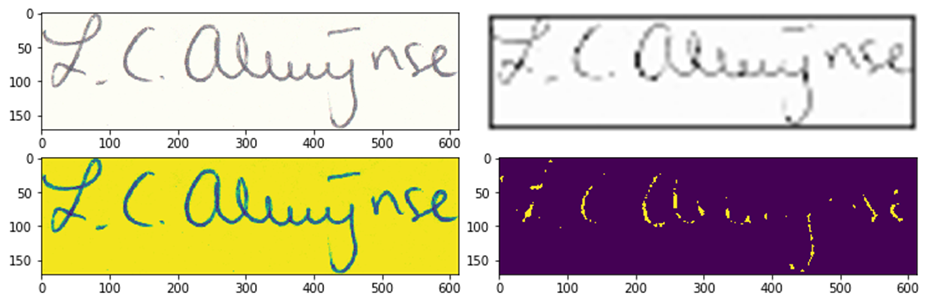
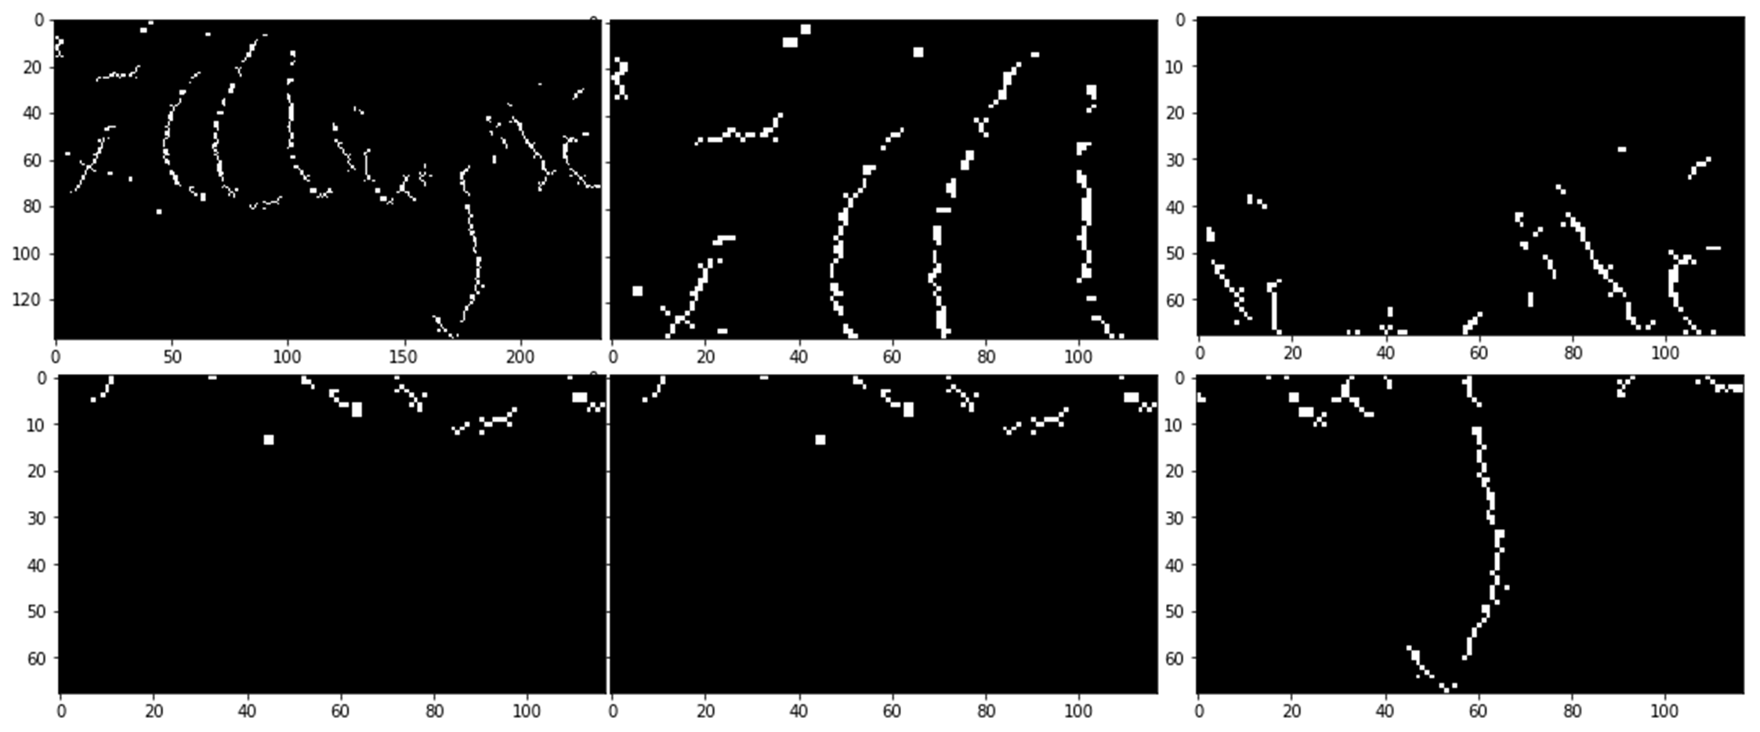
Signature Comparison – Features
INPUT
PROCESS
OUTPUT
Source Extraction
Signature from Client Form
Original Signature from Specimen repository
01
Cropped Signature from OTT Form
Transaction Amount and Currency
Specimen signatures of all signatory authorities as per Sig Cap system
Authorization mandate
Image Pre Processing
02
Image quality smoothing
Image noise removal – Shadows, Cross overs etc
Decision on Match / Un-Match
Flag on possible Forged
Feature Extraction
Strokes details – 18 Features
Image curvature – 4 Features
Image angles – 4 Features
03
Compare Signatures
04
Compare original and transaction signature
Determine Match % at 99% Confidence
Check Historical Genuine & Forged
Check whether the signature is similar to historical transactions which are considered Genuine and Forged
05
Features | Description | Illustration (Sample Signature Image)
Image Clean up | Noise removal – Image pixel distribution, cropping, shadow clean up, cross lines clean up etc Image binarization – Ink smudging removal, pixel normalization etc
Feature Extraction | Determine stoke level features like angle of inclination, curvature, area covered by the signature, intensity of inclination etc
Compare Signatures | Transaction sign is compared against specimen Transaction sign is checked for genuinity Transaction sign is checked for forgery | RESULT: The signature(s) can be accepted or not.

